Slide 1
Automation in a hybrid world
Jakob Gottlieb Svendsen @JakobGSvendsen
Global Lead Dev – Coretech Global

Slide 2
Agenda
What is OMS & Azure Automation?
Webhooks & Hybrid Worker
Scenario: New O365 User
OMS Alerts
Scenario: OMS Alerts - Locked Account SMS
Scenario: New ServiceNow Incident
Graph API – Moved to next session ☹

Slide 3
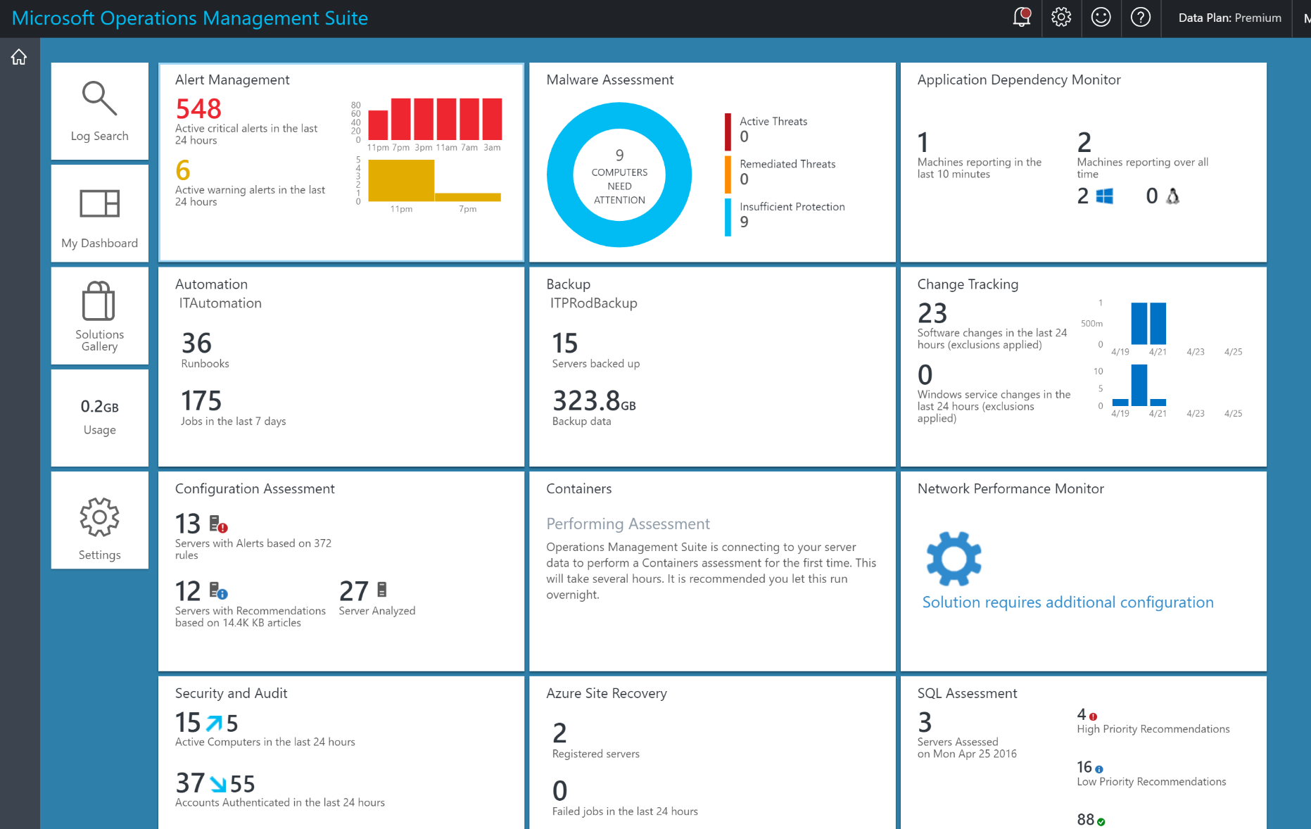
What is OMS?
Notes:
Vlad

Slide 4
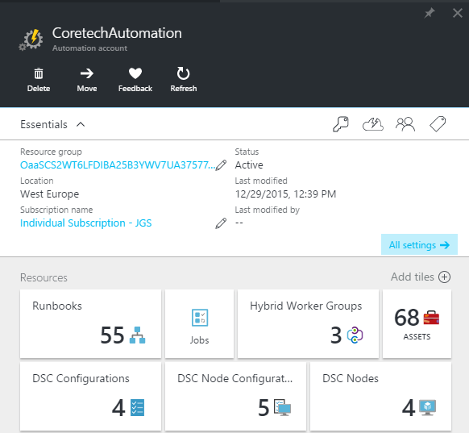
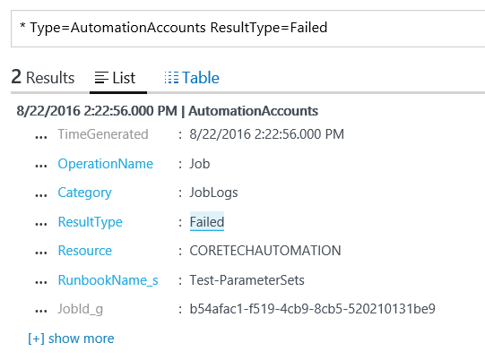
OMS/Azure Automation

Slide 5
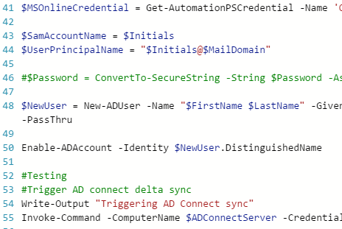
Textual Runbook Authoring
Distinct programming model
PowerShell Workflow or Scripts
Can use existing PowerShell scripts
Familiar to PowerShell users

Slide 6
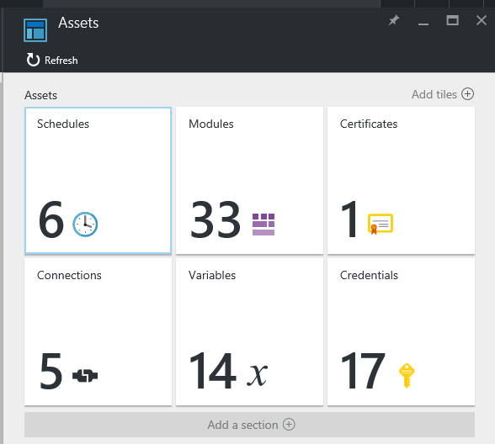
Resources + Assets
Resources
Runbooks
Jobs
Assets
Modules
Schedules
Certificates
Variables
Credentials
Connections
Notes:
Modules and Schedules are also Assets. OK :D

Slide 7
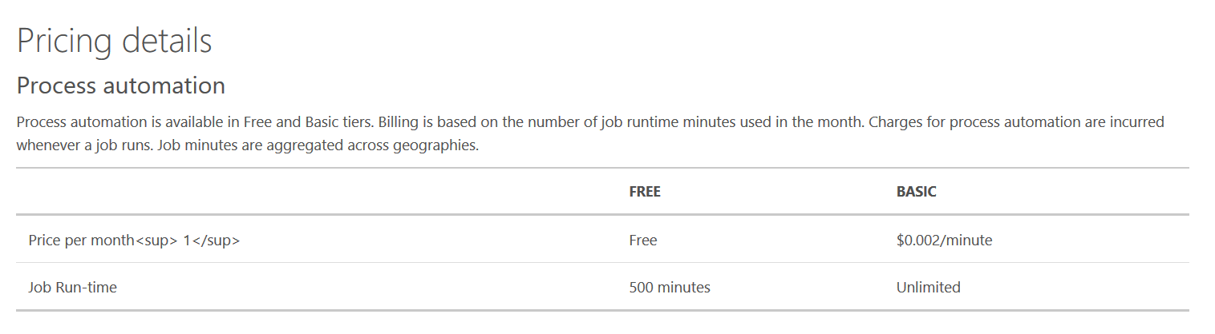
Pricing (US$)
US$ 1 =
500 Minutes

Slide 8
Reduce errors and boost efficiency
Reduction of time-consuming, error-prone cloud management tasks
Quick start of automation tasks using Runbook Gallery
Better visibility into automation activities
Creation, monitoring, management, and deployment of resources in hybrid environments
Ready-to-use automation sample, utility, and scenario runbooks
Runbook monitoring with easy-to-read dashboard charts and log records
Notes:
Creation, monitoring, management, and deployment of resources in hybrid environments
Securely manage and monitor tasks using a runbook across on-premises and cloud environments
Automate repetitive tasks with Azure Automation to start runbooks daily, hourly, or at a single point in the future
Ready-to-use automation sample, utility, and scenario runbooks
Import sample runbooks from Runbook Gallery or create your own
Leverage the work of the community to build runbooks quickly
Runbook monitoring with easy-to-read dashboard charts and log records
Use the chart, jobs table, and quick-glance section of the automation dashboard
Monitor the state of your runbooks and troubleshoot your runbook jobs

Slide 9
Orchestrating long-running processes
Integration with Azure and external services using Internet APIs
Faster, more consistent delivery of services
Automation activity reports
Integration with the services you depend on
Reliable automation through efficient handling of processes
Insight into and tracking of automation activities with detailed reporting
Notes:
Integration with the services you depend on
Automation runbooks work with Azure Websites, Virtual Machines, Storage, SQL Server, and other popular Azure services
Easily integrate virtually any service offering public Internet APIs
Reliable automation through efficient handling of processes
Create checkpoints to resume your workflow after unexpected errors, crashes, and network issues
Protect your long-running and expensive tasks from unexpected interruption
Automation activity reports
Get reports based on runbook and job information
Check up on your automation daily, schedule reports daily, and link runbooks to reports

Slide 10









Webhooks
Webhooks
Runbooks
Assets
DevOps
DevOps
Other clouds
Other clouds
Orchestrator

Slide 11

Hybrid Workers
Webhooks
Runbooks
Assets
DevOps
DevOps
On-Premises Data Center
On-Premises DMZ
Other Data Center(s)
Other clouds
Other clouds
Hybrid Worker (OMS Agent)
Domain Controller
Hybrid Worker (OMS Agent)
Orchestrator
Orchestrator

Slide 12
AzureRM REST API
All features available
Better than webhooks
https://docs.microsoft.com/en-us/rest/api/automation/

Slide 13





New O365 User via SharePoint
Form
Submitted
New List Item
Starts Flow
Webhook
End Users
OMS Automation
Hybrid Worker(s)
Receive Input
Create User
AD Connect Server
Domain Controller(s)
Start Sync to O365
Update SharePoint
Log Analytics
Orchestrator
Notes:
Jakob
After this demo,

Slide 14


Scenario: Add O365 license
Form
Submitted
New List Item
Starts Workflow
Webhook
Runbook
End Users
OMS Automation
Log Analytics
Orchestrator
Notes:
Jakob
After this demo,

Slide 15
Demo
New O365 User via SharePoint

Slide 16
OMS Alerts
A saved search and a condition
Trigger Action:
Send Email
Call Webhook
Start runbook (automatic webhook setup)

Slide 17





Locked Account SMS
Get Phone #
Send SMS
Webhook
Log Analytics
Unlock User
Webhook
OMS Automation
On-Premise Data Center
End Users
Domain Controller(s)
Hybrid Worker (OMS Agent)
Log Analytics
Orchestrator

Slide 18
Demo
OMS Alerts & Hybrid Workers

Slide 19
WebHooks
SharePoint (Online or on-prem)
ServiceNow / Other ITSM
Github / VSTS / TFS
Twilio
Zapier
PowerShell/Any Script/code
SCOM Recovery Action
Linux/BSD (curl, wget etc.)
And much more!

Slide 20

New ServiceNow Incident
Create Incident
Business Rule
Webhook
REST Message
End Users
OMS Automation
Log Analytics
Orchestrator

Slide 21
Summary
Use Webhooks instead of polling!
Use REST API if possible
Hybrid Workers rock!

Slide 22
Next Steps...
Now: 15 min break
Grab a coffee
Stay here to enjoy next presentation
Change track and switch to another room
Ask me questions or meet me in a breakout session room afterwards

Slide 23
Questions?

Slide 24
About_Author
Jakob Gottlieb Svendsen
@JakobGSvendsen
Global Lead Dev at Coretech Global
www.coretech.global
Blog: http://blog.coretech.dk/jgs/
Cloud & Data Center MVP

Slide 25
Demo
Try and use demos instead of dead slides.
Please do not dive into zillions of pages of code.
Instead, if you can, turn your logical code blocks into functions, and store them in a module.
Share this module with your audience.

Slide 26
$ErrorActionPreference = "stop"
trap [Exception] {
$ErrorMessage = "SCRIPT: SCSM-ImportData.ps1 failed`n"
$ErrorMessage += "Runas domain: $($env:userdomain)`n"
$ErrorMessage += "Script location: $PSScriptRoot`n`n"
$ErrorMessage += "Error: Line,char: {0},{1} - Details: {2}" -f $_.InvocationInfo.ScriptLineNumber,$_.InvocationInfo.OffsetInLine, $_.Exception
throw $ErrorMessage
continue;
}

